Slide 1

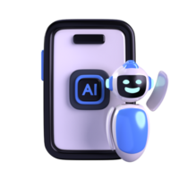
A Scalable, Adaptive Learning System for Enhanced Student Engagement
AI-Powered Personalized Tutor
A Scalable, Adaptive Learning System for Enhanced Student Engagementaph text
Team Members
Aleena Sabu
Deva Nandan S
Evangilin K
Institution: CHRIST(Deemed to be University)

Slide 2

Introduction & Problem Statement
Problem Statement
Traditional K-12 education follows a fixed syllabus.
No scope for personal pace or understanding.
Many students lag behind or lose interest.
Our Solution
A smart AI tutor that adapts to each student.
Tracks performance, recommends topics, simplifies learning.
Helps promote or repeat academic levels based on performance.

Slide 3

Key Objectives
Goal 1: Predict student readiness for promotion or repetition.
Goal 2: Assign Course Structure based on their performance level.
Goal 3: Recommend study materials depending on performance (Basic, Intermediate, Advanced).
Goal 4: AI-Powered Text Simplification:
Type 1: Clustering based on assessment, IQ, time spent
Type 2: Simplified notes based on Beginner/Advanced input

Slide 4
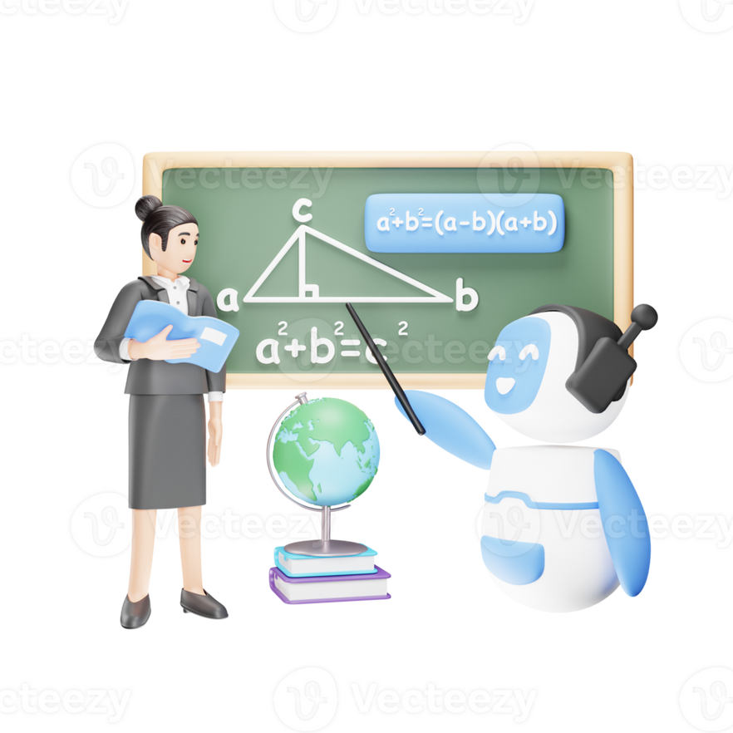
Key Objectives
Goal 1: Predict student readiness for promotion or repetition.
Goal 2: Assign Course Structure based on their performance level.
Goal 3: Recommend study materials depending on performance (Basic, Intermediate, Advanced).
Goal 4: AI-Powered Text Simplification:
Type 1: Clustering based on assessment, IQ, time spent
Type 2: Simplified notes based on Beginner/Advanced input

Slide 5
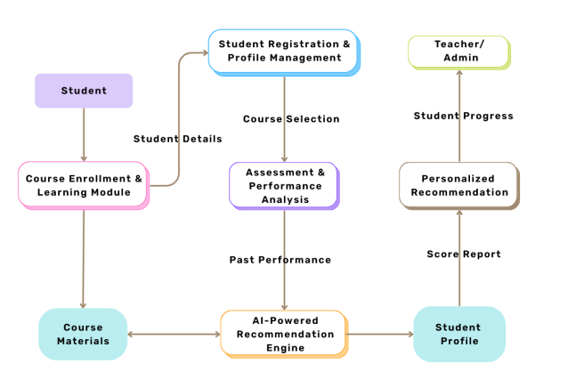
System Architecture
System Flow
Start → Data Load & Preprocessing
Predict score → Promote/ Repeat
Assign Topics → Recommend Material
Simplify Text → Display Notes

Slide 6
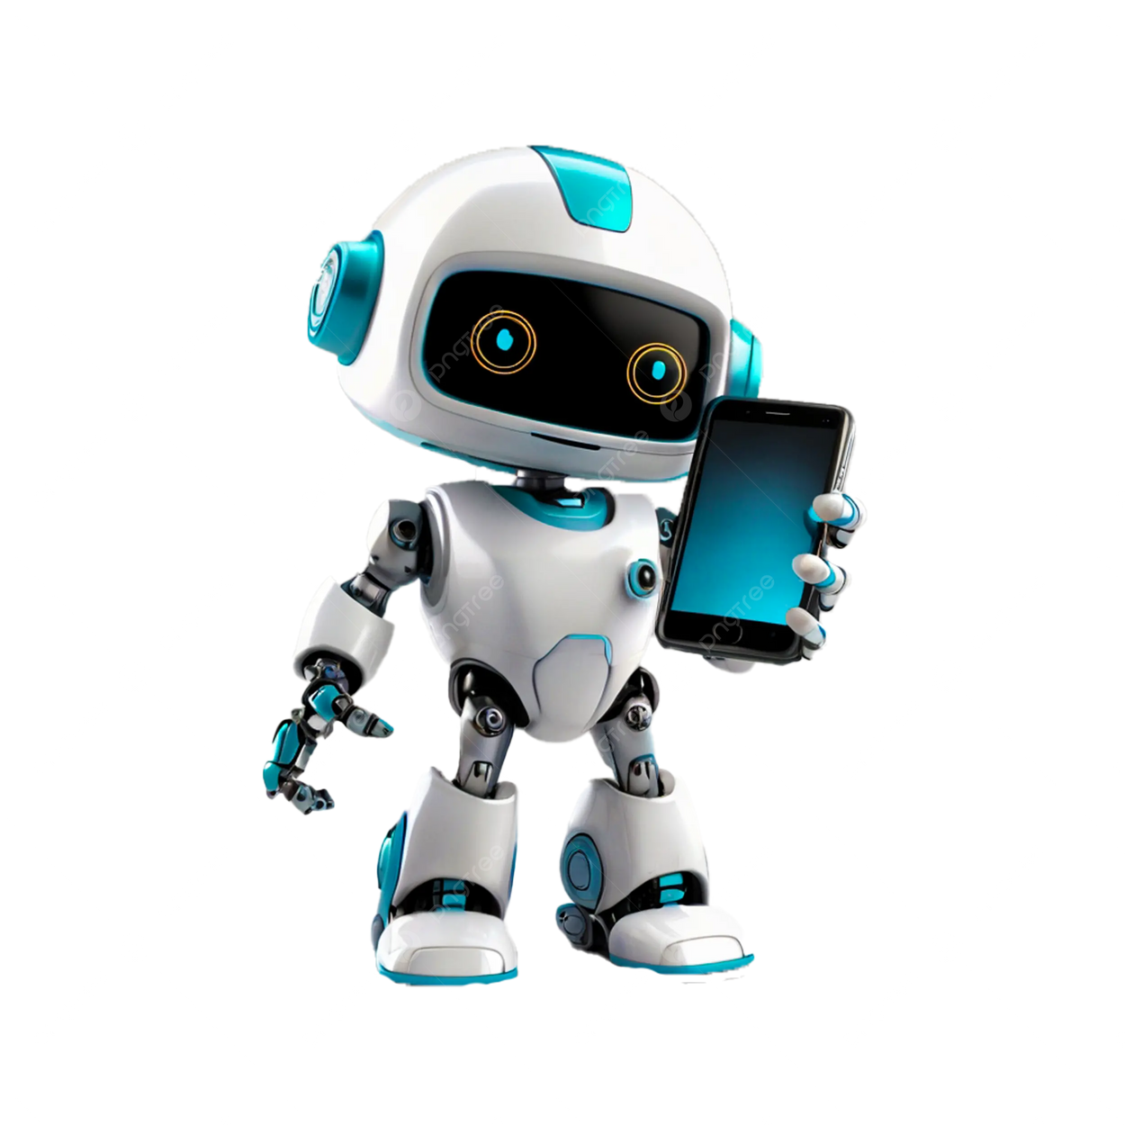
Implementation & Interface
Technologies Used
Machine Learning: Random Forest, XGBoost, LSTM
Data Handling: Python, Pandas, NumPy
NLP: Text simplification & classification
User Experience
Enters name & subject
Gets performance prediction
Receives customized notes
Learns via simplified content

Slide 7
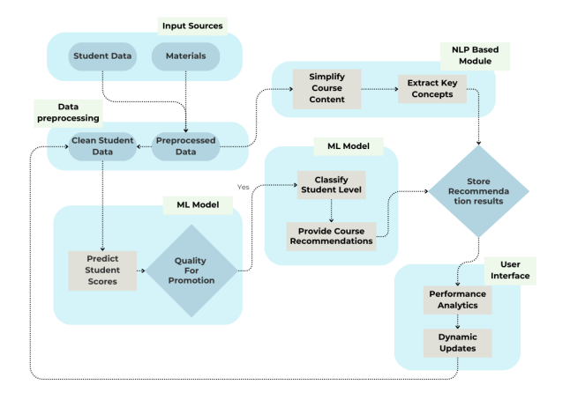
System Architecture of the AI-Powered Tutor
How Our AI Tutor Works: From Student Data to Smart Recommendations

Slide 8

Testing, Results & Outcomes
Testing
Evaluated prediction model on student datasets
Accuracy checked using confusion matrix & accuracy score
Feedback from simulated student interaction
Expected Outcomes
Higher student engagement
Targeted learning improvements
Flexible pacing and better retention

Slide 9

Conclusion & Future Enhancements
Conclusion
AI can personalize learning experiences
Helps bridge knowledge gaps
Boosts student confidence and performance
Future Enhancements
Voice-enabled tutoring assistant
Integration with Augmented/Virtual Reality
Expansion to other educational levels (college, skill-based learning)

Slide 10
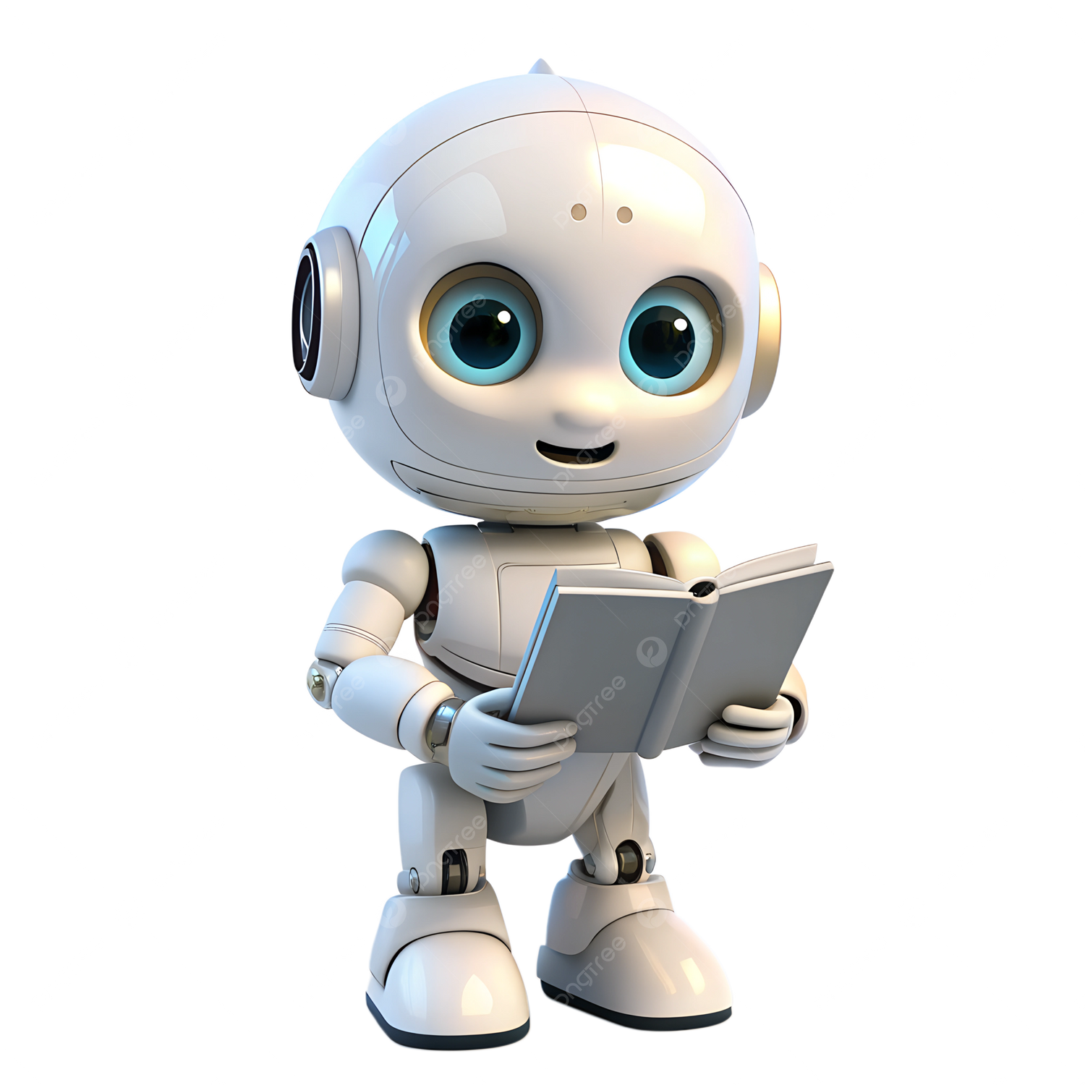
Thank You

